Slide 1
EIU Proposal
Group 3:
Faith Lee Kai Ling (U202207C)
Jensen Lim Chang Sheng (U2021364D)
Sim Miao Xuan (U2010155G)
Teresa Zhang Han Yu (U2022886C)

Slide 2
Table of contents
01
02
03
04
Introduction
Data Selection & Preparation
Linear Regression Model
CART Model

Slide 3
Table of contents
05
06
07
08
Comparing Models
Determining The Degree of Fluctuation
Value Adding EIU reports
Conclusion

Slide 4




Introduction
Entrepreneurs
Financiers
Government Officials
Jensen
Notes:
We understand that The economist intelligence unit has been created since 1946 providing forecasting and advisory services to assist entrepreneurs, financiers and government officials

Slide 5
Introduction
Expert Opinion and Domain Knowledge
Entrepreneurs
Financiers
Government Officials
1.Why use Machine Learning?
2.Why predict exchange rates?
Jensen
Notes:
We do recognize that the EIU does well in using expert opinion and domain knowledge to make their predictions for their clients, however my group’s goal is to more quantitatively predict exchange rates with machine learning. So you may be wondering why use machine learning and why should we use it to predict exchange rates

Slide 6

Introduction
1. Why use Machine Learning?
Allows EIU to expand their reach to more customers and providing them with more accurate predictions
Minimize forecasting error
Make Forecasting more efficient
5%
6%
More Productive
More Profitable
Jensen
Notes:
Explain why we predicting exchange rate and the sequence of the proposal tthjat we have

Slide 7

Introduction
1.Why use Machine Learning?
Difference between EIU traditional methods and our machine:
Currently most of EIU data are derived from expert opinions who study the market VS automated studying of all available past data to create a model for future values to be determined on
Jensen
Notes:
Having covered on why EIU should use machine learning you may wonder what is the main difference between EIU traditional methods and my group’s proposed machine learning methods. Currently as I said in the first few slide EIU is using expert opinions and survey to predict their values in their reports. Such methods may work due to EIU experience however it may sometimes be succeptable human biasnesss. On the other hand we have machine learning which is an automated studyding of a available past data to creat a model for future values to be determined on. Although it may not be perfect, it will not be succeptable to human biasness.

Slide 8

Introduction
1.Why use Machine Learning?
8 man
Data Science Team
Jensen
Notes:
One good example of a company that has used machine learning well would be PLURIBUS LAB. Pluribus Labs uses machine learning techniques to deliver predictive investment information. With just a team 8 data scientist they are able to train models to identify relevant patterns and capture the economic fundamentals in the data helping their company achieve huge efficiency benefits for their clients and increase the available information supporting trading decisions. As pluribus labs have a very similar model to EIU, it can be seen that there is a lot of growth potential if EIU were to start using machine learning.

Slide 9





Introduction
2.Why predict exchange rate?
Sound monetary policy &
Good government policies
Attracting foreign investors
Stable Currency
International companies that are dependent on trading partners
Affected by the fluctuation of exchange rate
Jensen
Notes:
Explain why we predicting exchange rate and the sequence of the proposal tthjat we have

Slide 10
Introduction
Created a machine learning model to complement their existing methodologies
Further process past data to form a scale to quantify the degree fluctuation
Using EIU extensive amount of economic data
Jensen
Notes:
Explain why we predicting exchange rate and the sequence of the proposal tthjat we have

Slide 11
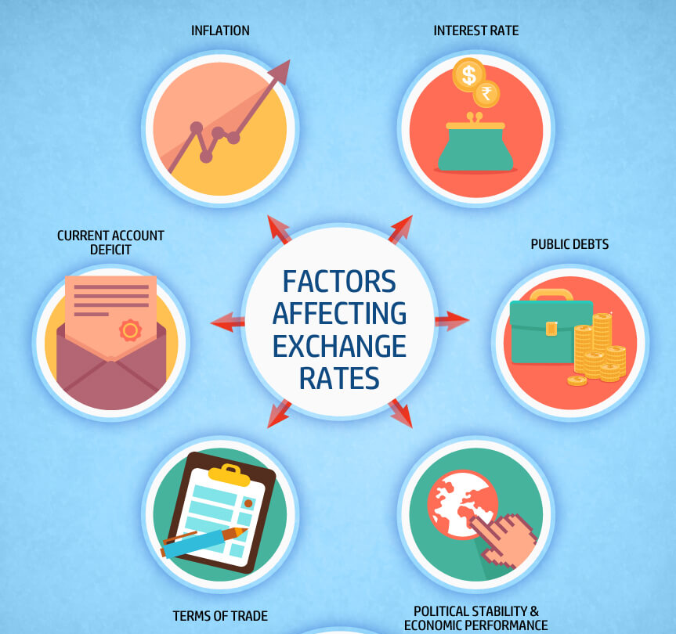
Dataset
Background research
Relevant x-variables:
Date
Inflation
Interest Rate
Public Debts
Political Stability & Economic Performance
Terms of Trade
Current Account Deficit
Teresa
Notes:
Thank you Jensen, now I will be talking about how we source our dataset and do the initial preparation.
We did some background research and found out that there are a few relevant x-variables that affect Exchange Rates, namely, inflation, interest rate, public debts, political stability and economic performance, terms of trade, and current account deficit.

Slide 12
Dataset
EIU Dataset includes:
Date
M1 Money supply
Stock of money M2
Real GDP
Private consumption
Gross fixed investment
Nominal GDP
Budget balance
Public debt
Lending interest rate
Deposit interest rate
Short term interest rate
Money market interest rate
Long-term bond yield
Consumer prices
Growth in average wages
Average real wages
Unemployment rate
Goods: exports
Goods: imports
Private sector credit/GDP
Exchange rate
Teresa
Notes:
Hence, we selected a dataset from EIU that contains many of these variables. It consists of 26 variables including exchange rate. The data span from 1993 to 2023 and were recorded on a quarterly basis. Thus, it provides us with sufficient data to work with.

Slide 13





Dataset
Countries that we’ve chosen:
Canada
Netherlands
Sweden
Russia
United Kingdom
Why they were chosen:
Large economies
Most complete dataset
Teresa
Notes:
Instead of just developing a predictive model on one country, we decided to try it on multiple countries. There are a few reasons for that. Firstly, we are able to compare the results and analysis between multiple countries. Secondly, we wanted to see if our model will be able to work on different countries.
The countries we decided on are Canada, Netherlands, Sweden, Russia, and United Kingdom. We chose these countries as they are large economies with a substantial hand to play in the global economy. Furthermore, we were able to find the most complete datasets on these countries, making our predictive analysis more robust as the data we obtained could paint a more complete picture in predicting exchange rates.

Slide 14
Data Cleaning
01
Check for data that could possibly be missing values
Replace “-” in our dataset to NA
Teresa
Notes:
Now I’ll talk about the steps we took for data cleaning.
Firstly, we checked for data that could possibly be missing values, for example "-". We replaced them with NA so that R can recognise it as missing values.

Slide 15
Data Cleaning
02
Make sure that all the class types of each variable make sense
Convert the class type of quarterly dates from character to date
Teresa
Notes:
Secondly, we made sure that all the class types of each variable make sense, if not, we convert them to the correct class type. For our dataset, R assigned the class type of quarterly dates as character, so we convert it to date.

Slide 16
Data Cleaning
03
Remove all the unnecessary data
All data after 2021Q2
Date
Exchange rate LCU:$ (end-period)
Money market interest rate (%; end-period)
M1 Money supply (LCU)
Stock of money M2 (LCU)
Export volume of goods and services (% change pa)
Import volume of goods and services (% change pa)
Teresa
Notes:
After that, we remove all the unnecessary data that we believed are repeated or do not help in our predictive model. We remove all data after 2021Q2 as they are forecasted data and thus, not accurate. We removed the date as it is not numerical and will affect the rest of data cleaning and machine learning. We removed these as we are using average period instead of end period. We removed these as they are not in USD. We removed these as they are repeated.

Slide 17
Data Cleaning
04
Check for values that do not make sense and correct them
Check for any negative values that are unlikely to be negative
Teresa
Notes:
Next, we check for values that do not make sense and correct them such as any negative values that are unlikely to be negative. For example, money supply, stock of money, nominal GDP and exchange rate. If they are negative, it’s likely to be incorrect and likely included by mistake.

Slide 18
Data Cleaning
05
Why not drop the entire row?
Clean the NA values
Dropping the entire column
Replacing the NA values with the respective mean of each column
Considerations
Value of correlation
Percentage of the NA values out of the rest of the data in the columns
<0.1
>30%
Drop the columns!
Teresa
Notes:
After these, we can start dealing with the NA values. We have decided on two ways to deal with them, by either dropping the entire column or replacing the NA values with the respective mean of each column. We decided to replace it with mean as they are continuous variables. You might be wondering, why did we choose to drop the entire column instead of the entire row? This is because when we drop the entire row, a lot of other datas from other variables will be dropped too, reducing the amount of data we are able to work with. Thus, unless most of the data in the row are NA, we decided against dropping the entire row.
To determine whether the entire column should be dropped or the NA values should be replaced with the mean, we export the respective columns along with Exchange Rate, omit the NA values, and check the correlation. We decided that if the value of correlation is less than 0.1 and the percentage of the NA values out of the rest of the data in the columns is more than 30%, we drop the columns, else, we keep the columns and replace the NA values with mean.

Slide 19
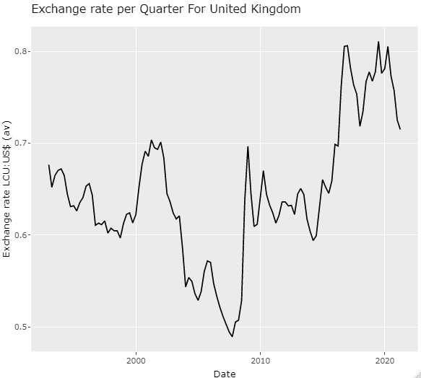
Data Exploration
Teresa
Notes:
Done with the initial cleaning, we plotted a graph of exchange rate against date to view how exchange rate changes along the years. From this graph, we can see that there’s a general depreciation till 2007, followed by a general appreciation.

Slide 20
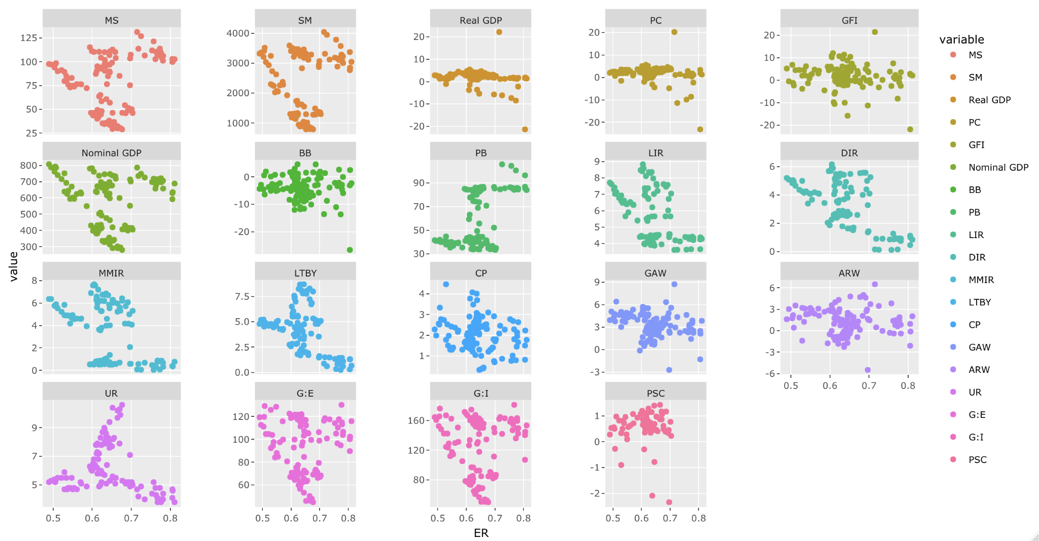
Data Exploration
Teresa
Notes:
We also plot all the relevant x variables against exchange rate to get a gist of the relationships between them.
We use ggplot and facet wrap to compare the relationships side by side.
As you can see here, there are weak linear relations between the variables and exchange rate, which follows from the relatively weak correlation values we found between them. From this, we can tell that a linear regression model may not be very representative of the actual relationship.

Slide 21
Variable Selection
If the correlation value is <0.1
Of no help during machine learning
Remove!
Teresa
Notes:
After dealing with the NA values, we did some simple variable selection. We look at the correlation of all the x variables with exchange rate and if the value is less than 0.1, we remove those variables, as they do not significantly impact exchange rate and we assume that they will not be of help during machine learning.

Slide 22
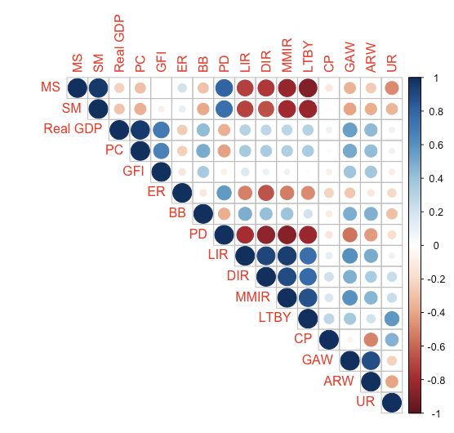
Data Exploration
Stock of Money M2
Lowest cor. with ER
Cor. coefficient = 0.11
Deposit Interest Rate
Highest cor. with ER
Cor. coefficient = -0.66
Teresa
Notes:
After we remove the x variables with low correlation, we then plot a heatmap for correlation of all the variables.
Taking a look at the heatmap, the x-variable with the highest correlation value is deposit interest rate at -0.66 and the x-variable with the lowest correlation value is stock of money m2 at 0.11. This can be seen more clearly in our correlation plot.

Slide 23
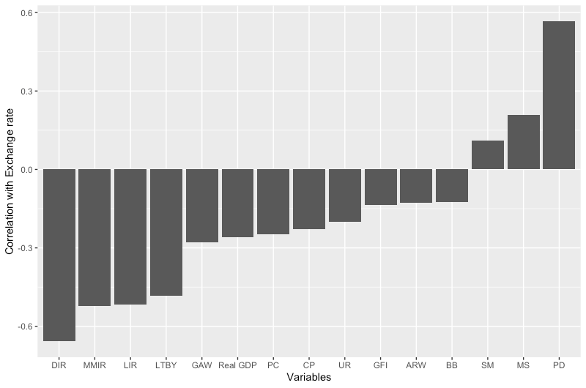
Data Exploration
Teresa
Notes:
This is the correlation plot of all the other variables against exchange rate only, from the variable with the most negative correlation, to the variable with the most positive correlation. Looking at this, you can clearly tell the variables with higher correlation values, and might be more significant during the machine learning process.

Slide 24
Linear Regression Models
How we created our linear regression models
Evaluating our findings
Reviewing our diagnostic plots
Faith

Slide 25
How We Created the Models
1. Created the Complete Model
2. Removed based on VIF
3. Backwards Elimination (AIC)
Using all variables after data cleaning
High VIF values indicate multicollinearity. An assumption of linear regression is that no multicollinearity is present. We removed until VIF < 10
Variables that did not provide a significant contribution to the prediction removed
Faith

Slide 26

Live Demonstration in R
Now, we will demonstrate how we derived UK’s linear regression model in R
Faith

Slide 27
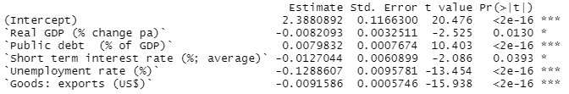
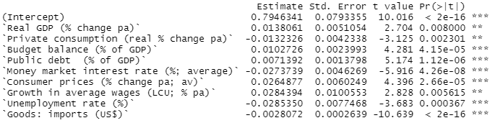
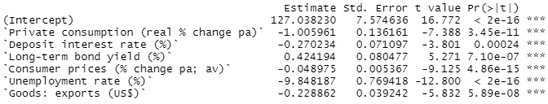
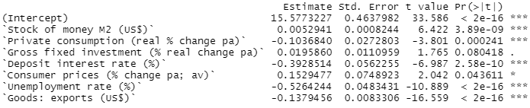
Models
Canada
Netherlands
Russia
Sweden
All variables have p-value < 5% and hence are significant in modelling exchange rates (except for `Gross fixed investment` for Sweden’s model)
Our decision to remove based on VIF, then AIC was sound
Faith

Slide 28
Evaluating Linear Regression Models
Country |  | Model | Trainset Error | Testset Error
Canada | 1 | Complete | 0.034374 | 0.037026
 | 2 | VIF | 0.074768 | 0.078237
 | 3 | AIC | 0.074768 | 0.078237
Netherlands | 4 | Complete | 0.035298 | 0.039499
 | 5 | VIF | 0.047603 | 0.072332
 | 6 | AIC | 0.047603 | 0.072332
Russia | 7 | Complete | 7.779643 | 12.124396
 | 8 | VIF | 9.443954 | 10.172301
 | 9 | AIC | 9.595250 | 9.324460
Faith

Slide 29
Evaluating Linear Regression Models
Sweden | 10 | Complete | 0.322075 | 0.407612
 | 11 | VIF | 0.500180 | 0.512381
 | 12 | AIC | 0.508453 | 0.439762
UK | 13 | Complete | 0.024581 | 0.029124
 | 14 | VIF | 0.038313 | 0.031272
 | 15 | AIC | 0.038705 | 0.030144
Highlighted in green are the train/test errors of our finalised linear regression models
Faith

Slide 30
Our Findings
The errors generally increased after removing based on VIF. However, it was still a important step to do to eliminate multicollinearity
In general, train and test error were not hugely different and train error < test error, showing that there was no significant under or overfitting in the models. Some exceptions:
Test error >> train error at rows 6 & 7, suggesting under/over fitting
Test error < train error at rows 12, 14, and 15. Could be due to chance occurrences
Russia’s seemingly high error is due to its higher exchange rate compared to the rest
Faith

Slide 31
Variable Occurrences
X Variable | Private Consumption | Budget Balance | Public Debt | Short Term Interest Rate
Occurrences | 3 | 1 | 2 | 1
X Variable | Consumer Prices | Exports | Real GDP | Long-term Bond Yield
Occurrences | 4 | 4 | 2 | 1
X Variable | Money Market Interest Rate | Growth in Average Wages | Unemployment Rate | Imports
Occurrences | 1 | 1 | 5 | 1
X Variable | Stock of Money | Gross Fixed Investment | Deposit Interest Rate
Occurrences | 2 | 2 | 3
We see some parallels to real-life, lending some legitimacy to our linear model
Currently, our sample size is too small to create a linear model in general
In order to do that, we should conduct linear regression on many more countries and tabulate the variable occurrences
Variable occurrences in each of the 5 models created
Faith

Slide 32
Examining Diagnostic Plots
Some assumptions of linear regression:
Linear relationship between variables
Residuals follow a normal distribution
Residuals have a constant variance
No influential outliers
No multicollinearity (We handled using VIF)
We can look into diagnostic plots to verify these assumptions.
We will examine Russia’s plots as our example.
Faith

Slide 33
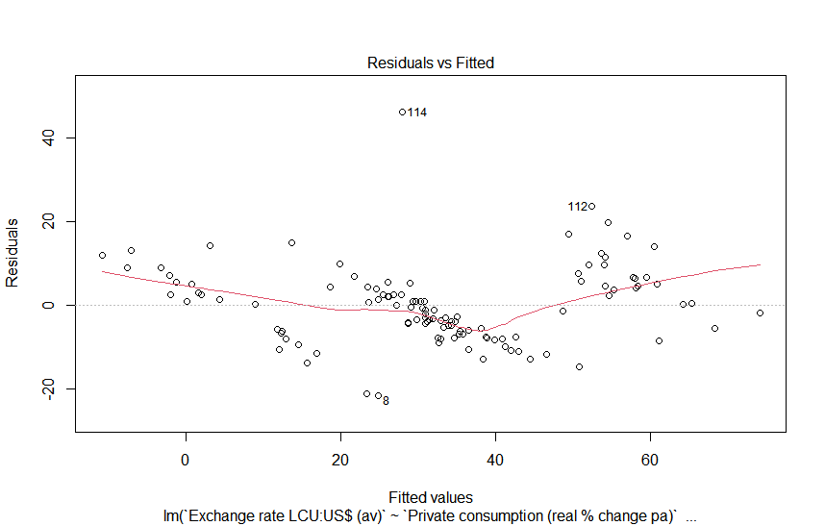
Residuals vs Fitted
Verify the assumption of linearity
Good plots have an approximately horizontal red line at zero
For Russia, line curves at both ends -> relationship may not be linear
Faith

Slide 34
Residuals vs Fitted
Verify the assumption of linearity
Good plots have an approximately horizontal red line at zero
For Russia, line curves at both ends -> relationship may not be linear
Faith

Slide 35
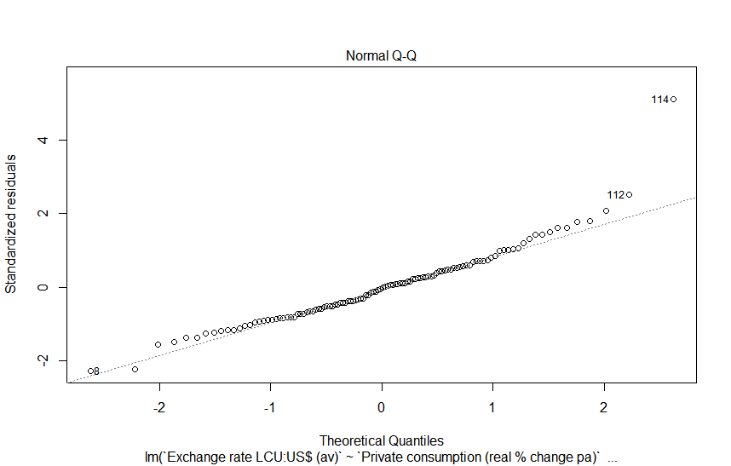
Normal Q-Q
Verify the assumption of normality
Ideally, the plot should follow a straight line
For Russia, points generally fall nicely on a straight line
Faith

Slide 36
Normal Q-Q
Verify the assumption of normality
Ideally, the plot should follow a straight line
For Russia, points generally fall nicely on a straight line
Faith

Slide 37
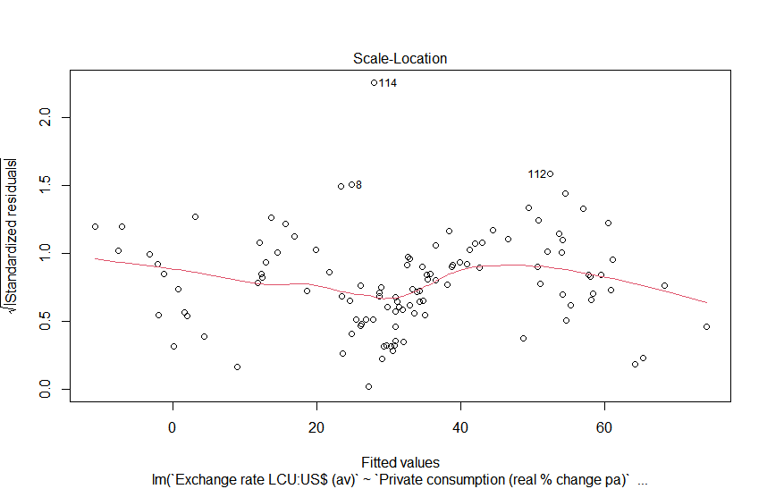
Scale-Location
Verify the assumption of constant variance
Good plots have an approximately horizontal red line and equally spread points
For Russia, points are not very well distributed throughout the range, but the red line is moderately horizontal
Faith

Slide 38
Scale-Location
Verify the assumption of constant variance
Good plots have an approximately horizontal red line and equally spread points
For Russia, points are not very well distributed throughout the range, but the red line is moderately horizontal
Faith

Slide 39
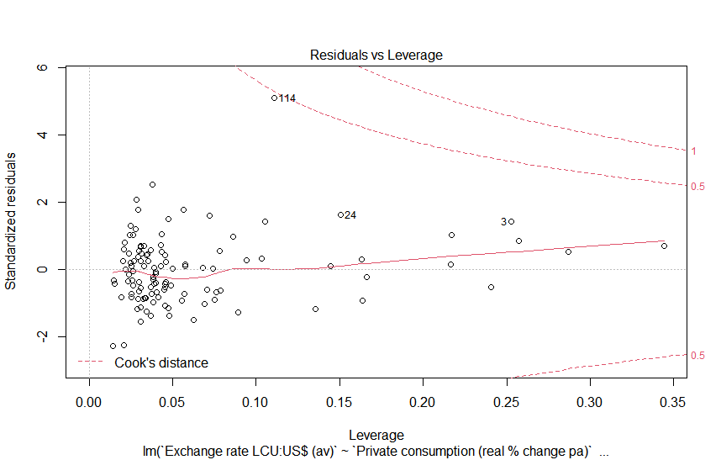
Residuals vs Leverage
Pick out influential outliers
Not all outlier are influential
Ideally, all plots should fall within the Cook’s distance
For Russia, only point 114 lies close to the Cook’s boundary. It could be an influencing outlier
Faith

Slide 40
Residuals vs Leverage
Pick out influential outliers
Not all outlier are influential
Ideally, all plots should fall within the Cook’s distance
For Russia, only point 114 lies close to the Cook’s boundary. It could be an influencing outlier
Faith

Slide 41
Linear Regression Conclusion
May not be the most suitable model, since in our data visualisation we did not see strong linear relationships
However, it provided some insight into variables that may have a notable relationship with exchange rate
Faith

Slide 42
How We Created the CART Models
1. Create model using rpart
2. Obtain CV error
3. Optimal Tree
Split into train and test sets; apply the “anova” method
obtain at each prune trigger minimum CV error and its 1SE to get error cap
Prune using optimal cp value
Miao Xuan

Slide 43
Live Demonstration in R
Now, we will demonstrate how we derived Canada’s CART model in R
Miao Xuan

Slide 44
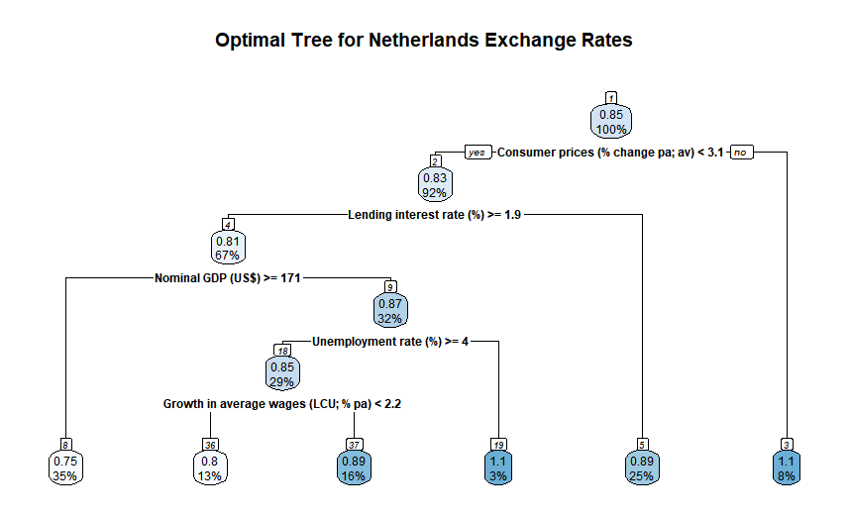
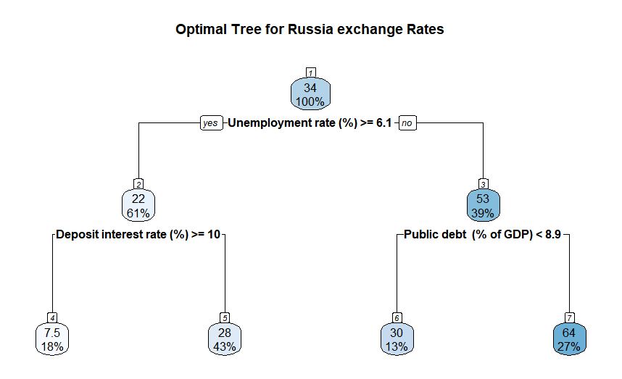
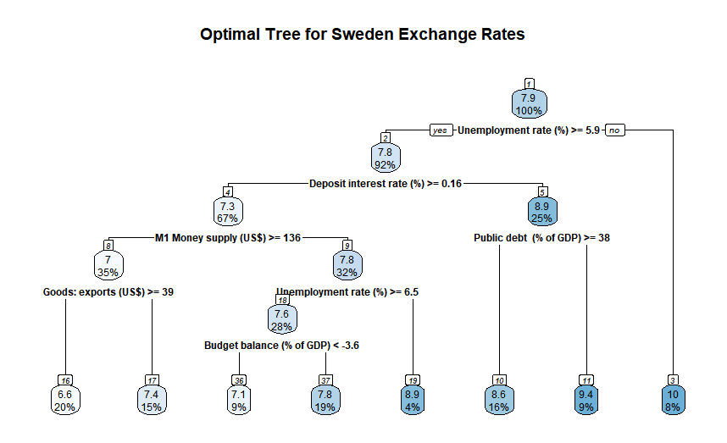
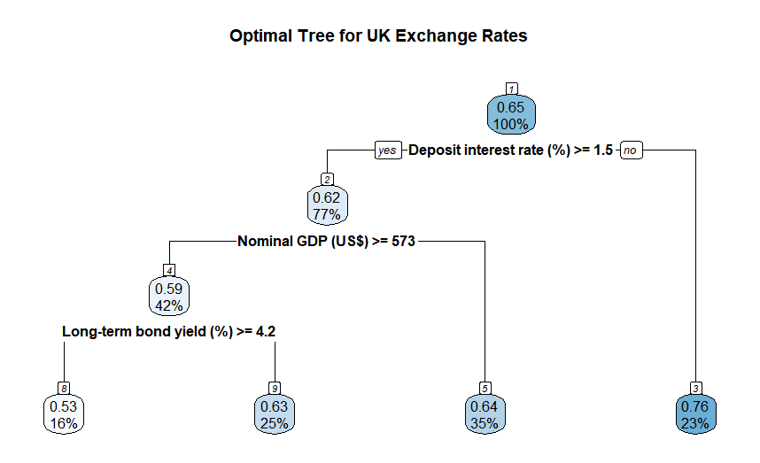
CART Model
Miao Xuan

Slide 45
CART Model
> rmse(testsetc$`Exchange rate LCU:US$ (av)`, predictc) [1] 0.07258788
Country | RMSE value
Canada | 0.072758788
Netherlands | 0.09855255
Russia | 11.97997
Sweden | 0.8849531
United Kingdom | 0.03437773
Miao Xuan

Slide 46

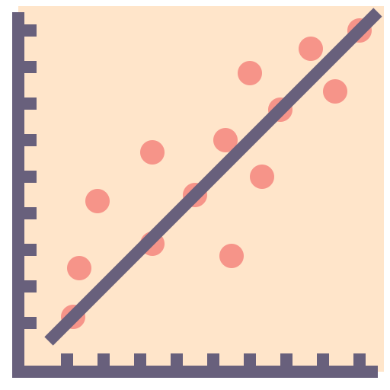

Selecting Between Linear and CART
Miao Xuan

Slide 47
Selecting Between Linear and CART
CART
Linear Regression
Country | RMSE value
Canada | 0.078237
Netherlands | 0.072332
Russia | 9.324460
Sweden | 0.439762
United Kingdom | 0.030144
Country | RMSE value
Canada | 0.072758788
Netherlands | 0.09855255
Russia | 11.97997
Sweden | 0.8849531
United Kingdom | 0.03437773
Miao Xuan

Slide 48



Selecting Between Linear and CART
Handling NA values
Ease of variable prediction
Automation
Miao Xuan

Slide 49
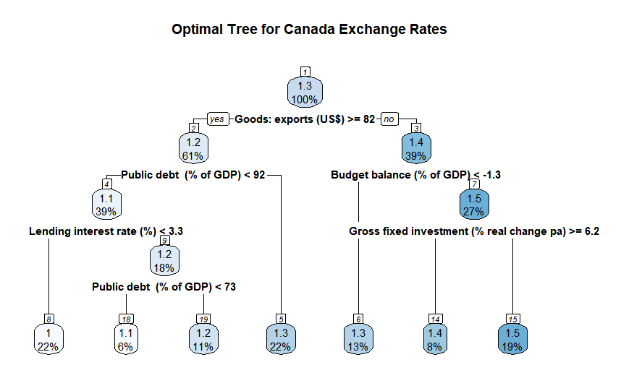
CART Variable Importance
Miao Xuan

Slide 50
CART Variable Importance
Miao Xuan

Slide 51
CART Variable Importance
Miao Xuan

Slide 52
CART Variable Importance
Miao Xuan

Slide 53
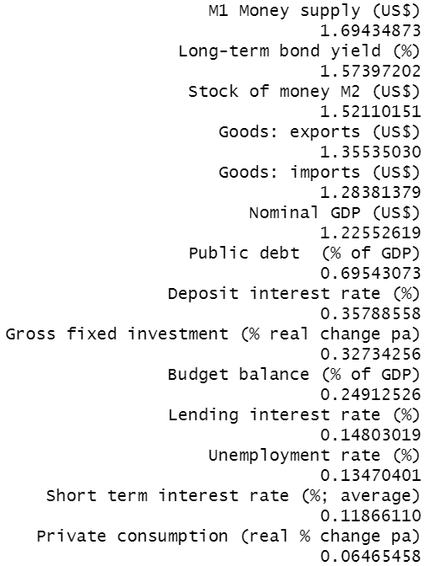
CART Variable Importance
Miao Xuan

Slide 54

Formulating our scale
203
1960-2020
Different countries
Worth of data
139
2000-2020
Jensen
Notes:
Now I will explain how my group formulated our scale to determine the degree of fluctuations in different country’s currency. To formulate this scale, we took data from the World Bank which provided us with exchange rate of 203 different countries from the year 1960 to 2020. For data cleaning we first decided to remove the data from the years 1960 to 1999 as we wanted to use more recent data to make our scale more relevant for our current day use. After that we then removed all the constant exchange rates as we assume that this is erroneous data as it is almost impossible that an exchange rate is constant for 20 years. We further removed countries that 0 values in their exchange rate as World Bank indicated that they were unable to retrieve those country’s rate during those years. After those deletion, we calculated the year on year percentage change by taking the difference of the current year’s exchange rate and the previous year’s exchange rate divided by the previous year’s exchange rate before multiplying it by 100. Having attained the percentage changes for the years 20001 to 2020, we then calculated the mean percentage change of each country’s exchange rate. We then plotted a boxplot using this data as shown in the slide. This boxplot then helps our group formulate a scale for the degree of fluctuation of exchange rates for different countries where any mean percentage low than 5.00% the 1st quartile can be deemed as ther lowest degree of fluctuation of exchange rate while any value above 8.36% the 3rd quartile can be considered as the highest degree of fluctuation.

Slide 55
Formulating our scale
Current Year’s exchange rate – previous year exchange rate
Jensen
Notes:
Now I will explain how my group formulated our scale to determine the degree of fluctuations in different country’s currency. To formulate this scale, we took data from the World Bank which provided us with exchange rate of 203 different countries from the year 1960 to 2020. For data cleaning we first decided to remove the data from the years 1960 to 1999 as we wanted to use more recent data to make our scale more relevant for our current day use. After that we then removed all the constant exchange rates as we assume that this is erroneous data as it is almost impossible that an exchange rate is constant for 20 years. We further removed countries that 0 values in their exchange rate as World Bank indicated that they were unable to retrieve those country’s rate during those years. After those deletion, we calculated the year on year percentage change (excluding 2000) by taking the difference of the current year’s exchange rate and the previous year’s exchange rate divided by the previous year’s exchange rate before multiplying it by 100. Having attained the percentage changes for the years 20001 to 2020, we then calculated the mean percentage change of each country’s exchange rate. We then plotted a boxplot using this data as shown in the slide. This boxplot then helps our group formulate a scale for the degree of fluctuation of exchange rates for different countries where any mean percentage low than 5.00% the 1st quartile can be deemed as ther lowest degree of fluctuation of exchange rate while any value above 8.36% the 3rd quartile can be considered as the highest degree of fluctuation.

Slide 56
Formulating our scale
Current Year’s exchange rate – previous year exchange rate
Previous Year Exchange Rate
Jensen
Notes:
Now I will explain how my group formulated our scale to determine the degree of fluctuations in different country’s currency. To formulate this scale, we took data from the World Bank which provided us with exchange rate of 203 different countries from the year 1960 to 2020. For data cleaning we first decided to remove the data from the years 1960 to 1999 as we wanted to use more recent data to make our scale more relevant for our current day use. After that we then removed all the constant exchange rates as we assume that this is erroneous data as it is almost impossible that an exchange rate is constant for 20 years. We further removed countries that 0 values in their exchange rate as World Bank indicated that they were unable to retrieve those country’s rate during those years. After those deletion, we calculated the year on year percentage change (excluding 2000) by taking the difference of the current year’s exchange rate and the previous year’s exchange rate divided by the previous year’s exchange rate before multiplying it by 100. Having attained the percentage changes for the years 20001 to 2020, we then calculated the mean percentage change of each country’s exchange rate. We then plotted a boxplot using this data as shown in the slide. This boxplot then helps our group formulate a scale for the degree of fluctuation of exchange rates for different countries where any mean percentage low than 5.00% the 1st quartile can be deemed as ther lowest degree of fluctuation of exchange rate while any value above 8.36% the 3rd quartile can be considered as the highest degree of fluctuation.

Slide 57
Formulating our scale
Current Year’s exchange rate – previous year exchange rate
X 100
Previous Year Exchange Rate
Jensen
Notes:
Now I will explain how my group formulated our scale to determine the degree of fluctuations in different country’s currency. To formulate this scale, we took data from the World Bank which provided us with exchange rate of 203 different countries from the year 1960 to 2020. For data cleaning we first decided to remove the data from the years 1960 to 1999 as we wanted to use more recent data to make our scale more relevant for our current day use. After that we then removed all the constant exchange rates as we assume that this is erroneous data as it is almost impossible that an exchange rate is constant for 20 years. We further removed countries that 0 values in their exchange rate as World Bank indicated that they were unable to retrieve those country’s rate during those years. After those deletion, we calculated the year on year percentage change (excluding 2000) by taking the difference of the current year’s exchange rate and the previous year’s exchange rate divided by the previous year’s exchange rate before multiplying it by 100. Having attained the percentage changes for the years 20001 to 2020, we then calculated the mean percentage change of each country’s exchange rate. We then plotted a boxplot using this data as shown in the slide. This boxplot then helps our group formulate a scale for the degree of fluctuation of exchange rates for different countries where any mean percentage low than 5.00% the 1st quartile can be deemed as ther lowest degree of fluctuation of exchange rate while any value above 8.36% the 3rd quartile can be considered as the highest degree of fluctuation.

Slide 58
Formulating our scale
Current Year’s exchange rate – previous year exchange rate
X 100
Previous Year Exchange Rate
Mean Percentage Change of each country’s exchange rate
Jensen
Notes:
Now I will explain how my group formulated our scale to determine the degree of fluctuations in different country’s currency. To formulate this scale, we took data from the World Bank which provided us with exchange rate of 203 different countries from the year 1960 to 2020. For data cleaning we first decided to remove the data from the years 1960 to 1999 as we wanted to use more recent data to make our scale more relevant for our current day use. After that we then removed all the constant exchange rates as we assume that this is erroneous data as it is almost impossible that an exchange rate is constant for 20 years. We further removed countries that 0 values in their exchange rate as World Bank indicated that they were unable to retrieve those country’s rate during those years. After those deletion, we calculated the year on year percentage change (excluding 2000) by taking the difference of the current year’s exchange rate and the previous year’s exchange rate divided by the previous year’s exchange rate before multiplying it by 100. Having attained the percentage changes for the years 20001 to 2020, we then calculated the mean percentage change of each country’s exchange rate. We then plotted a boxplot using this data as shown in the slide. This boxplot then helps our group formulate a scale for the degree of fluctuation of exchange rates for different countries where any mean percentage low than 5.00% the 1st quartile can be deemed as ther lowest degree of fluctuation of exchange rate while any value above 8.36% the 3rd quartile can be considered as the highest degree of fluctuation.

Slide 59
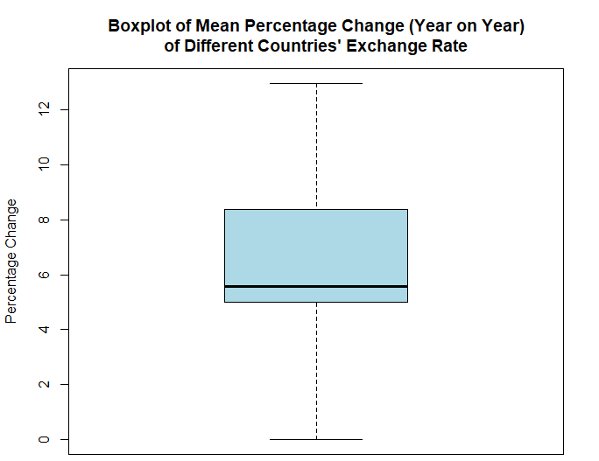
Formulating our scale
Third Quartile: 8.36%
First quartile: 5%
Jensen
Notes:
Now I will explain how my group formulated our scale to determine the degree of fluctuations in different country’s currency. To formulate this scale, we took data from the World Bank which provided us with exchange rate of 203 different countries from the year 1960 to 2020. For data cleaning we first decided to remove the data from the years 1960 to 1999 as we wanted to use more recent data to make our scale more relevant for our current day use. After that we then removed all the constant exchange rates as we assume that this is erroneous data as it is almost impossible that an exchange rate is constant for 20 years. We further removed countries that 0 values in their exchange rate as World Bank indicated that they were unable to retrieve those country’s rate during those years. After those deletion, we calculated the year on year percentage change (excluding 2000) by taking the difference of the current year’s exchange rate and the previous year’s exchange rate divided by the previous year’s exchange rate before multiplying it by 100. Having attained the percentage changes for the years 20001 to 2020, we then calculated the mean percentage change of each country’s exchange rate. We then plotted a boxplot using this data as shown in the slide. This boxplot then helps our group formulate a scale for the degree of fluctuation of exchange rates for different countries where any mean percentage low than 5.00% the 1st quartile can be deemed as ther lowest degree of fluctuation of exchange rate while any value above 8.36% the 3rd quartile can be considered as the highest degree of fluctuation.

Slide 60
Determining the Degree of Fluctuations
2.54%
1.76%
11.96%
Canada
Netherlands
Russia
2.80%
0.83%
Sweden
UK
Jensen
Notes:
To demonstrate our scale, we decided to obtain the degree of fluctuation in the 5 countries just now. Having decided that our cart model is more suitable, we used the cart model to predict the exchange rates from 2000 to 2020 of the five countries we have chosen. For…… Hence from the scale we can easily dedecue that Russia has the highest degree of fluctuation which is true if you were to observe the exchange rate graph

Slide 61
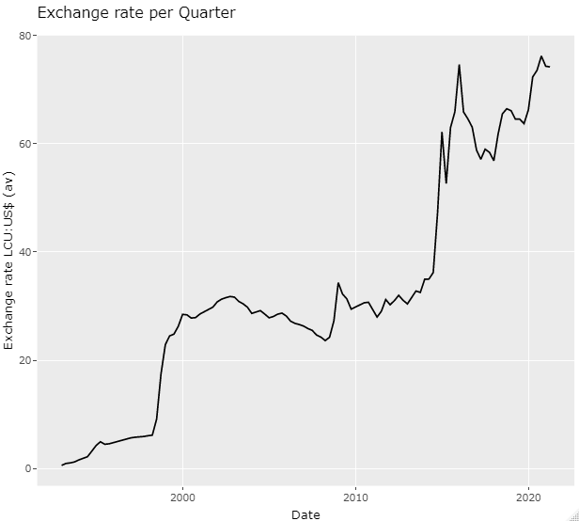
Determining the Degree of Fluctuations
2015 1st Quarter: 52.6 RUB
2014 4th Quarter: 47.3 RUB
2014 3rd Quarter: 36.2 RUB
1999 1st Quarter: 22.88 RUB
1998 4th Quarter: 17.44 RUB
1998 3rd Quarter: 9.12 RUB
1998 2nd Quarter: 6.15 RUB
Jensen
Notes:
To demonstrate our scale, we decided to obtain the degree of fluctuation in the 5 countries just now. Having decided that our cart model is more suitable, we used the cart model to predict the exchange rates from 2000 to 2020 of the five countries we have chosen. For…… Hence from the scale we can easily deduce that Russia has the highest degree of fluctuation which is true if you were to observe the exchange rate graph

Slide 62


Value Adding To EIU Reports
CART
Predicting Future Exchange Rates
Future stability using the predicted exchange rates
Scale
Jensen
Notes:
With that, we have proven CART to be a useful model in predicting future exchange rates, and the degree of stability scale to be useful in determining future stability using the predicted exchange rate. Hence we strongly suggest that EIU uses our machine learning model to predict exchange rate as it allows them to arrive at a concrete, quantified value which can be further refined by their expert inputs and survey. Furthermore the scale explained earlier can be made flexible for the data that EIU is trying to study on. For instance if EIU were to determine the degree of fluctuation of exchange rate of a country from a different year range other than 2000 to 2020. New data can be fed into the scale, making the scale more applicable to the period that EIU wants to examine.

Slide 63

Value Adding To EIU Reports
Country reports
Exchange Rate Stability
Jensen
Notes:
These finding can constitute in a new section in EIU’s Flagship Country Reports Under a section titled “Exchange rate stability” in the forecasting reports. This section would particularly be of value to multinational companies and companies looking to expand overseas or source from overseas. After reading this section of the report, they can make decisions accordingly to ensure that international ventures do not suffer losses in times of predicted high currency risk. For example a company based in Singapore could be heavily reliant on a company in the united states for their materials. Hence if they were to use our machine learning model, they may know whether in the future that the singapore dollar will depreciate or appreciate with respect to the US dollar allowing the singapore company to make decisions now that may help them avoid loses in the future. To continuously improve this CART model, we also suggest that EIU constantly feed and test the CART machine learning model with new and updated data.

Slide 64

Conclusions
Challenges Regarding Assumptions made:
Dependent on the accuracy of EIU prediction of the selected independent variables
Independent variables inserted in our CART models may not be the only major variables that affect the exchange rate.
Jensen
Notes:
As my team has proven the functionality of using the CART model to recommend exchange rate data for different countries and the degree of fluctuation in future exchange rates. It is conceded that good predictions from our machine learning CART model for future exchange rates will be dependent on the accuracy of EIU predictions of the selected independent variables. Hence our team recommends EIU to further explore multiple machine learning models to predict the other data in their country reports so that the predicted independent variables that they put in our CART model will be as accurate as possible for the prediction of future exchange rates. However we understand that some of the independent variables in our decision tree may be difficult to predict and this is also an additional reason why we chose the CART model over the linear regression model, as the CART model can use surrogates when the data at a decision split is unavailable, allowing EIU to be flexible in predicting independent variables to be put in our CART model to predict future exchange rates.
Lastly, we also recognise that the independent variables inserted in our CART models may not be the only major variables that affect the exchange rate. For example, with the current Covid-19 pandemic, EIU has actually included data rating on how well governments are reacting to the pandemic and it has been proven that this data has a direct impact on the economy itself. Since the exchange rate is directly related to the economy itself, when more of such data are released from EIU, EIU could include them in our CART machine learning model so that the model may be more accurate. Hence we encourage EIU to include data from their special reports that they might find that are correlated to exchange rate to be added to our CART model to make it more accurate.

Slide 65

Conclusion
Jensen
Notes:
In conclusion, Having recognised that there may be some shortfalls to our CART model, we still believe that the CART machine learning model is still a good consideration for EIU in predicting their exchange rate data. Our team believes instead of using machine learning as a replacement to their current multiple forecasting methodologies, we see machine learning as a valuable addition in helping to further improve the accuracy of their overall country report. We also believe that the method used to formulate a scale for the degree of fluctuation is a very valuable addition to the EIU reports as it helps their client to be able to foresee degrees of fluctuation on a scale. By continuously feeding the CART model with new data making it more accurate over the years, we believe that EIU can remain as the top company that provides forecasting and advisory services to assist entrepreneurs, financiers, and government officials.

